Slide 1
Data pipeline

Slide 2
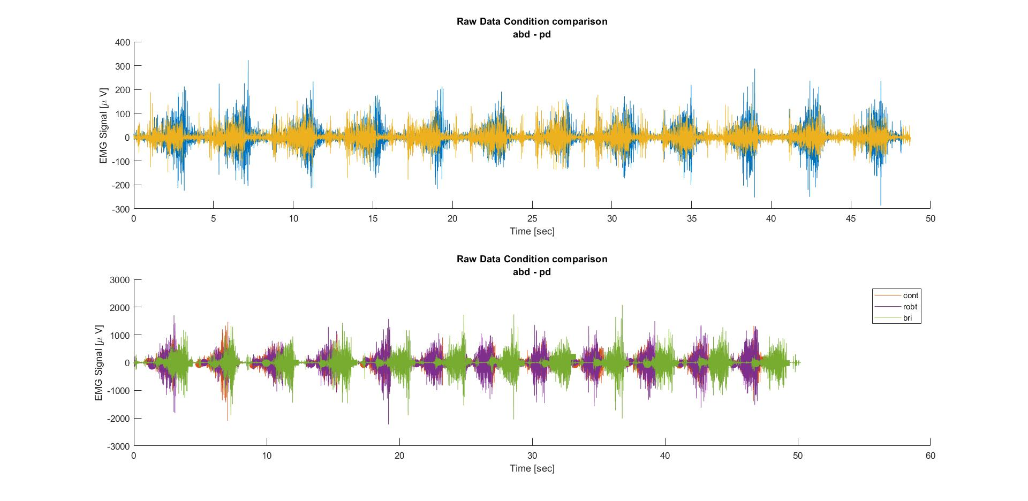
Raw Data: 3 Conditions + 2x Baseline for 6 muscles
X6 muscles

Slide 3
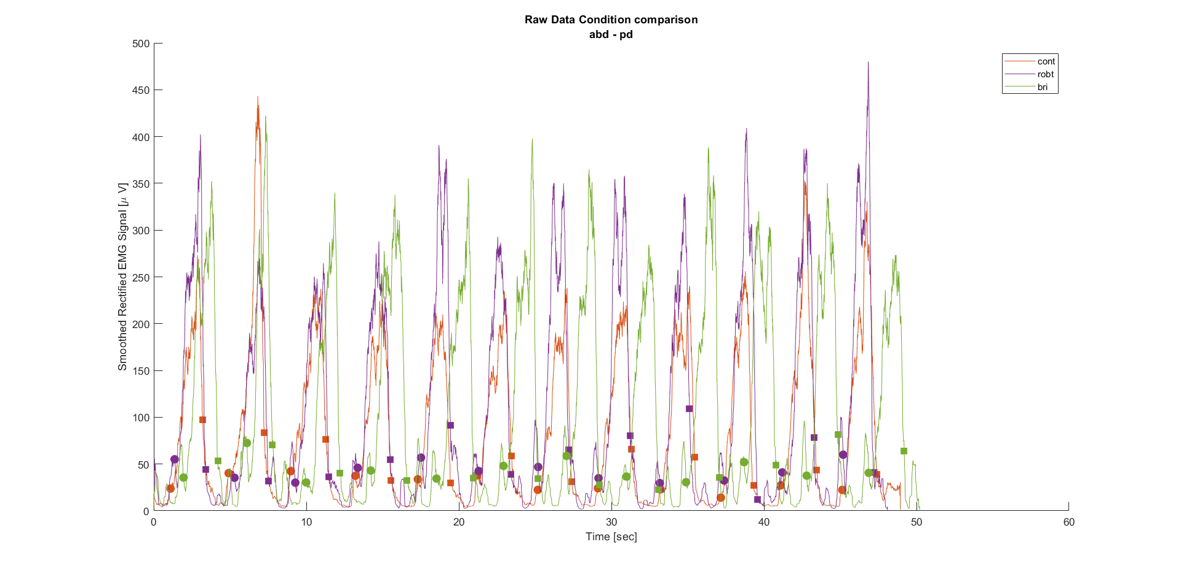
Smooth & Rectify (SRE)
X6 muscles

Slide 4
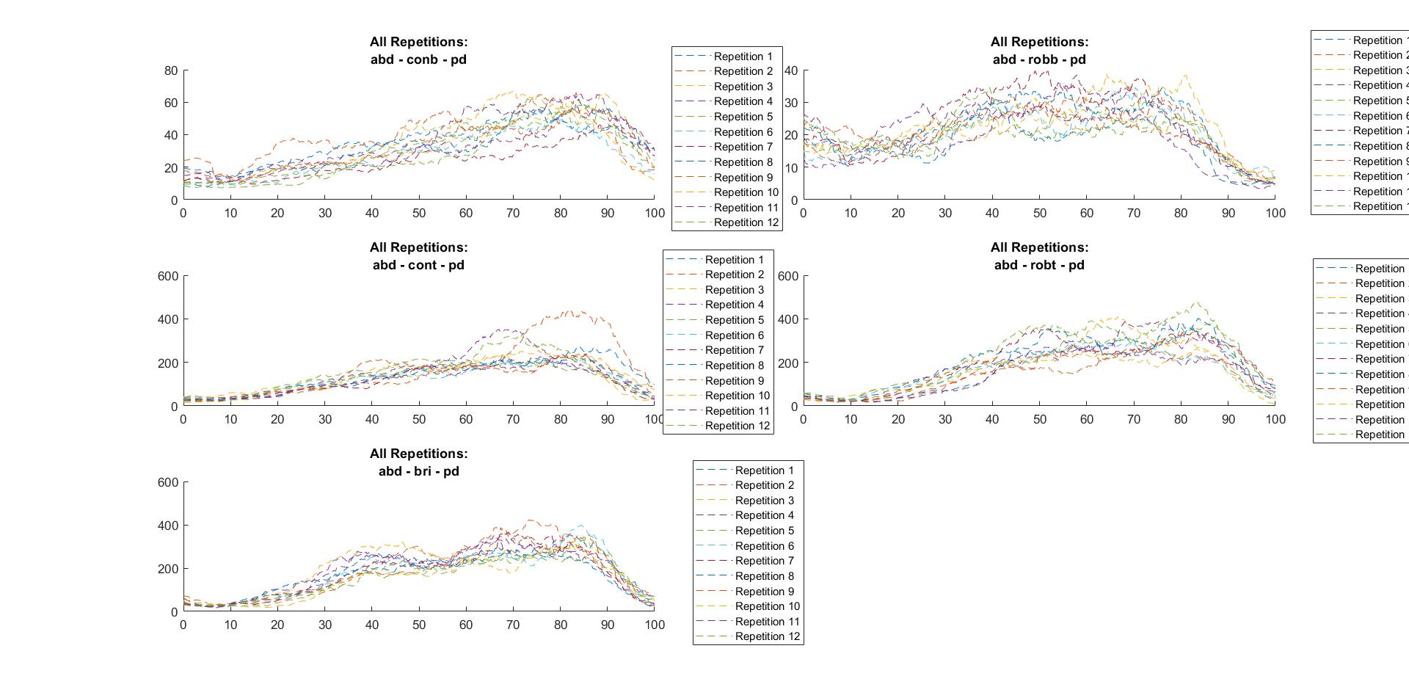
Cut EMG with MoCap Endeffector Markers Norm Time to 0%-100%
X6 muscles

Slide 5
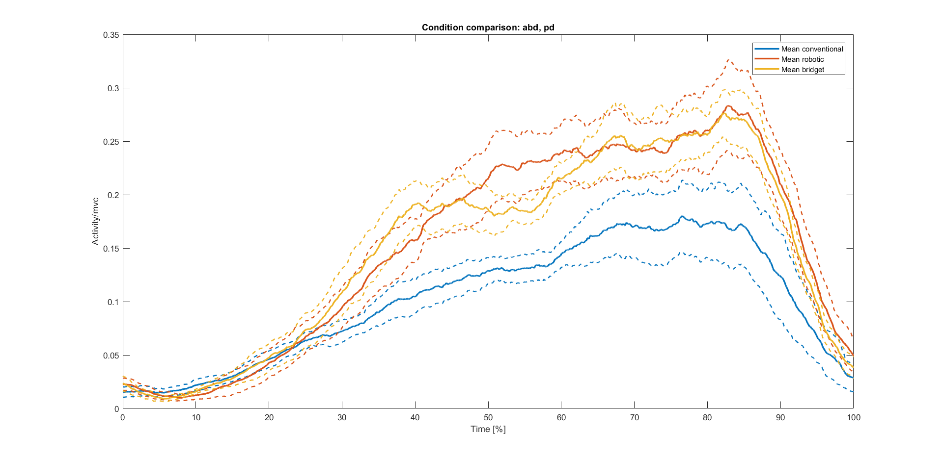
Compute Means and Intervals of Confidence
X6 muscles

Slide 6
Subtract Mean Baseline from Mean Condition, Norm with MVC
X6 muscles

Slide 7
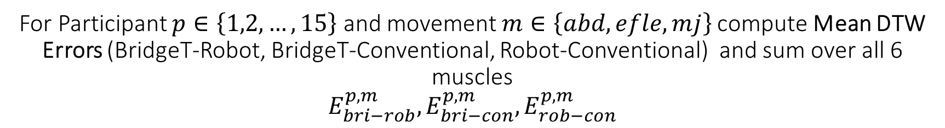
For Participant $p∈\left\{1,2,…,15\right\}$ and movement $m∈\left\{abd,efle,mj\right\}$ compute Mean DTW Errors (BridgeT-Robot, BridgeT-Conventional, Robot-Conventional) and sum over all 6 muscles $$E_{bri−rob}^{p,m},E_{bri−con}^{p,m},E_{rob−con}^{p,m}$$
Sum over 6 muscles!!

